Slide 1
INFARCT LOCATION USING 12 LEADS ECG
Research 3A project – week 3 report
Pham Khoi Nguyen

Slide 2
Index:
Severity of Myocardial Infarction
Diagnosis: ECG versus CT Angiography
Heart Anatomy
Case study
Treatment
Summary
References

Slide 3
1. Severity of mi:
Myocardial Infarction
Reduced Contractility
Electrical Instability
Tissue Necrosis
Hypotension
Arrhythmia
Inflammation
Perfusion
Cardiogenic Shock
Leading cause of death
Fatality: 70 – 90%
ischemia

Slide 4
2. Ecg versus ct angiography:
 | ECG | CT Angiography | Echocardio | MRI
Dependencies | None | ECG gated to obtain optimal image resolution [1,2] | ECG gated | Is not dependant on ECG but usually taken with ECG
Time requirement | 5 – 10 minutes [7] | 2 – 3 hours including preparation [9] | 20 – 30m + 10 – 20m (with Doppler effect) | 30m, or 50 – 60m for contrast enhancement
Additional drugs | None | Beta block Nitroglycerin Contrast agent Safety medication [9] | White gel | Contrast enhancement agent

Slide 5
2. Ecg versus ct angiography:
 | ECG | CT Angiography | Echocardio | MRI
Complication | None | Allergy Radiation exposure [9] | None | None
ED Standard Procedure | Yes | Recently being proposed [10] | Used for advance disagnosis | Re – test for healed MI
Cost | Low cost but routine trip to hospital [10] | High cost but take only one measurement [10] | High cost due to required medical peronel | High cost

Slide 6
2. Ecg versus ct angiography:
 | ECG | CT Angiography | Echocardio | MRI
Effectiveness | General information about the location of blockage | Specific location can be point out | Specific location can be pointed out with transosophageal echocardiography | Specific, 3D model of heart
 | Possible to miss ischemic events | Information are less likely to be missed [7][10] | Additional info: Size and shape Function Tissue damage | Additional info: Size and shape Function Tissue damage
Usage | Infarct location Coronary blockage | Infarct location Coronary blockage | Infarct location Coronary blockage (low sensitivity) Heart activity Tissue damage Thrombolysis | Infarct location Coronary blockage Heart activity Reversible vs inreversible MI

Slide 7
2. Ecg versus ct angiography:
conclusion:
ECG is still a strong and reliable technique for acute MI
Using CT instead of ECG has no overall improvement regarding: cost and effectiveness, but increase in radiation exposure
[10]

Slide 8
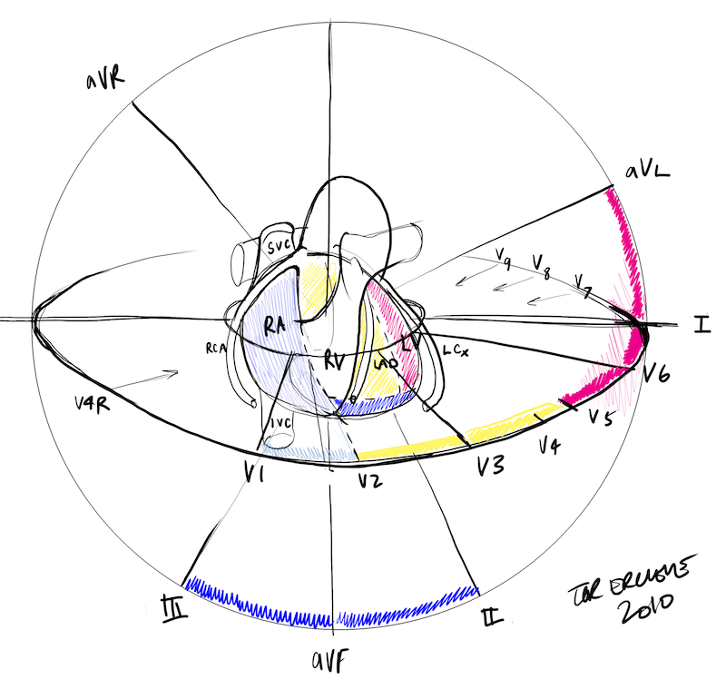
3. Heart anatomy:
Surface
Anterior
Septal
Inferior
Lateral
Posterior

Slide 9
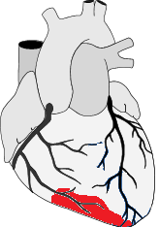
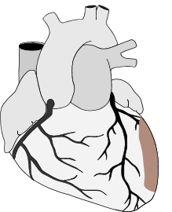
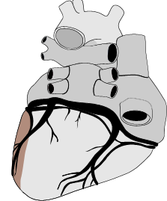
3. Heart anatomy:

Slide 10
3. Heart anatomy:
Inferior:
Inferior and RV
Inferolateral MI
Inferoposterior MI
Arteries: RCA, LAD
I
II
III
aVR
aVL
aVF
V1
V2
V3
V4
V5
V6

Slide 11
3. Heart anatomy:
Septal
Arteries: LAD
I
II
III
aVR
aVL
aVF
V1
V2
V3
V4
V5
V6

Slide 12
3. Heart anatomy:
Anterior
Arteries: LAD
I
II
III
aVR
aVL
aVF
V1
V2
V3
V4
V5
V6

Slide 13
3. Heart anatomy:
Lateral
Arteries: LAD
I
II
III
aVR
aVL
aVF
V1
V2
V3
V4
V5
V6

Slide 14
3. Heart anatomy:
Posterior
Arteries: LCx
Posterolateral: LAD, LAX
I
II
III
aVR
aVL
aVF
V1
V2
V3
V4
V5
V6
V7
V8
V9

Slide 15
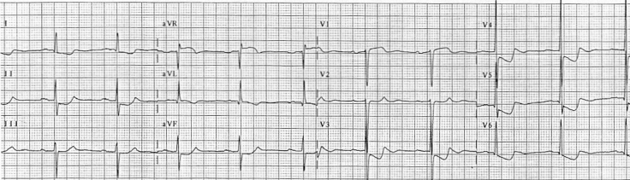
4. Case study:
Case 1: ECG of a patient with unrelieved chest pain. His biomarker is normal. [7]
STE: V1, AVR
STD: I, II, AVL, AVF, V3 – V6
RCA Blockage or Triple vessel disease
Classification: STEMI
Treatment: catheter

Slide 16
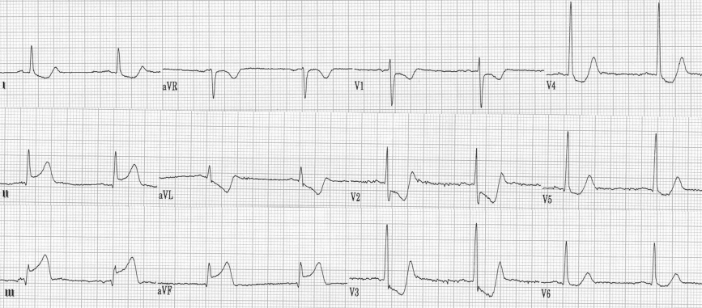
4. Case study:
Case 2: ECG of a patient with unrelieved chest pain. [7]
STE: II, III, AVF
STD: I, AVR, AVL, V1 – V4
Q wave: III, AVF
Inferior wall, posterior wall involved
Classification: STEMI

Slide 17
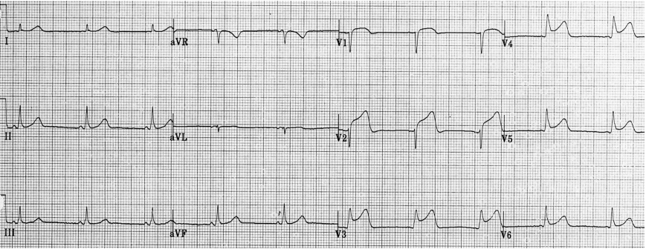
4. Case study:
Case 3: ECG of a patient with unrelieved chest pain. [7]
STE: V1 – V6
STD: AVR
Proximal LAD infartion
Classification: STEMI

Slide 18
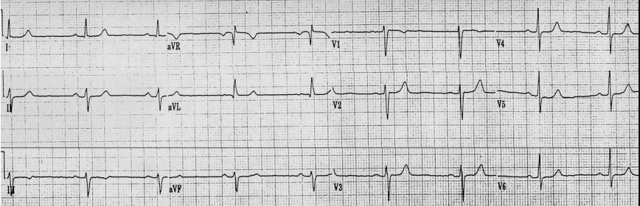
4. Case study:
Case 4: ECG of a patient with unrelieved chest pain. Troponin normal
STE: AVR
STD: none
Classification: UA

Slide 19
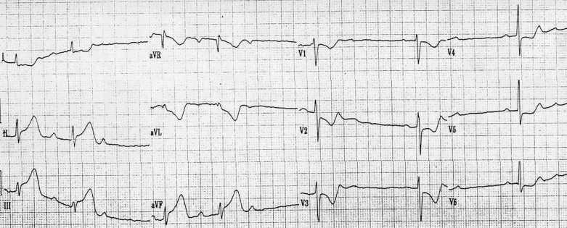
4. Case study:
However, after 2 weeks her pain worsen and her ECG was:
STE: II, III, AVF
STD: All other leads
Severe RCA Blockage, lead to Inferior Infarction
Classification: STEMI

Slide 20
4. Case study:
Key points:
ST deviations are more important than T wave inversion on MI diagnosis [3]
STE on AVR , suspect RCA Blockage, perform ECG with V1R – V4R [7]
For NSTEMI, perform troponin, biomarker test [3][7]
For STEMI, look for STE [7]

Slide 21
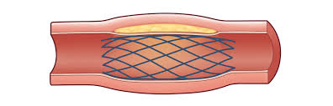
5. treatment:
1. Stenting:
Open up coronary arteries

Slide 22
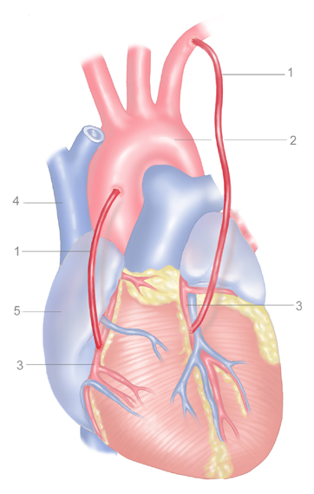
5. treatment:
2. Bypass Graff:
Take blood from other place to supply the infarcted area.

Slide 23
6. summary:
ECG is a strong diagnosis technique for acute MI dues to its:
Cheap, quick => ED
Non – invasive
No allergy, complication
Reliable, effective
[10]

Slide 24
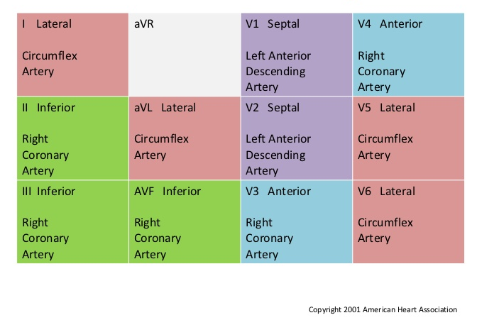
6. summary:

Slide 25
7. references:
1. Image window optimization for ACCT
2. Influence of heart rate on image quality of ACCT
3. ECG prediction of UA and Non – Q wave MI
4. Diagnosis efficiency of troponin T
5. Patient management in case of STE MI
6. Electrocardiographic Localization of Coronary Artery narrowing
7. ECG Diagnosis of Acute Coronary Syndrome

Slide 26
7. references:
8. Guidelines for the diagnosis and treatment of non-ST-segment elevation acute coronary syndromes
9. Coronary CT Angiography: complete guide
10. CCTA versus traditional ECG for MI

Slide 27
Thank you

